Slide 1

Performance Testing of Chatbot
Follow me at @ www.linkedin.com/in/debraj-adhikari-8080a921

Slide 2
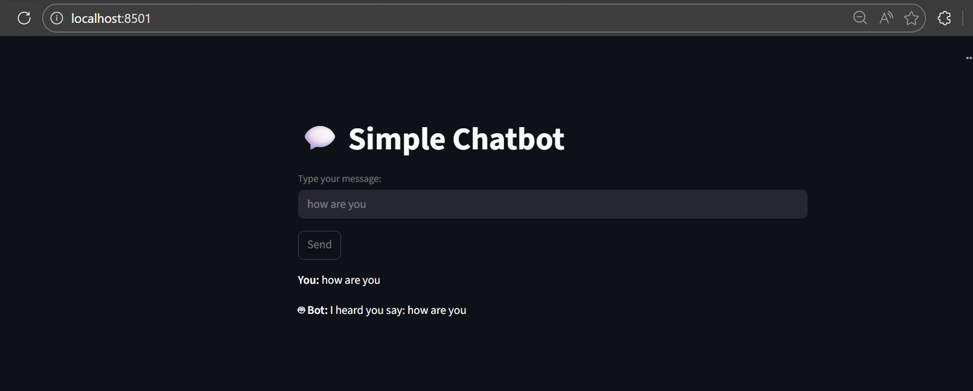
Setting up Chatbot
We have used Python + Streamlit to setup a very basic chatbot on our local system

Slide 3
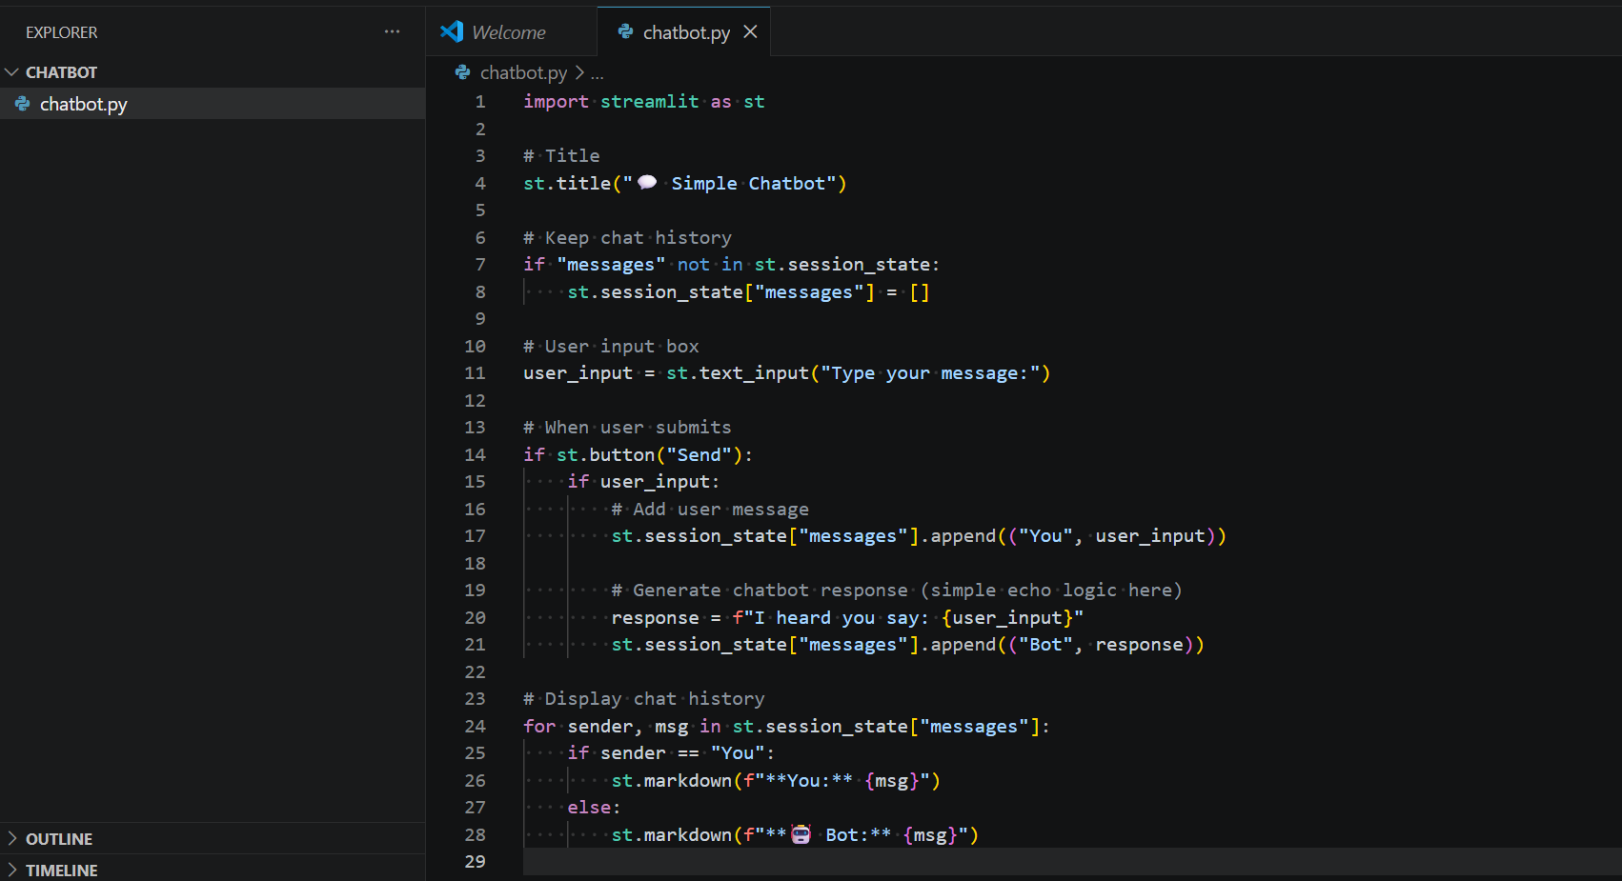
Setting up Chatbot
Code in Python with streamlit library

Slide 4
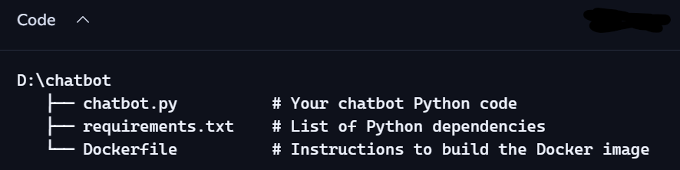
Setting up Chatbot
We will build a docker file for this chatbot and host it in the docker desktop

Slide 5
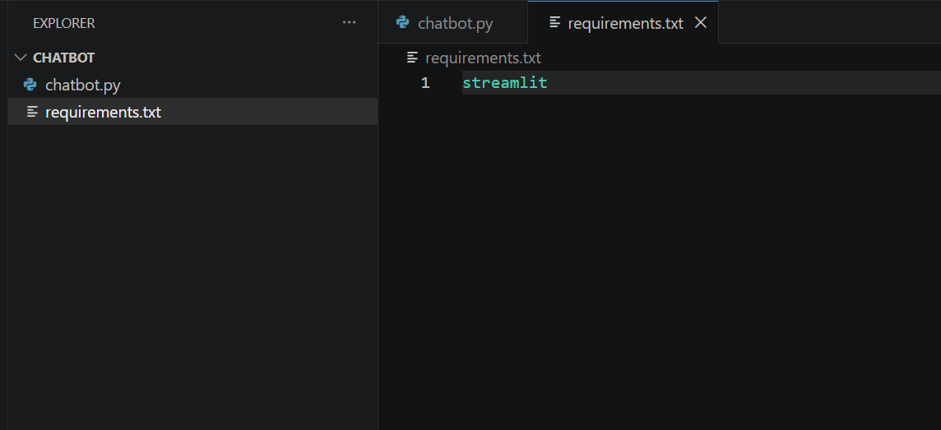
Setting up Chatbot
Requirements.txt

Slide 6
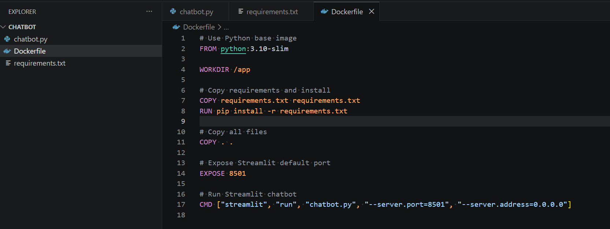
Setting up Chatbot
Docker File

Slide 7

Setting up Chatbot
Everything is ready now
Python streamlit Code
Requirements
Docker File
Now we will build the image and run the container on Docker desktop

Slide 8
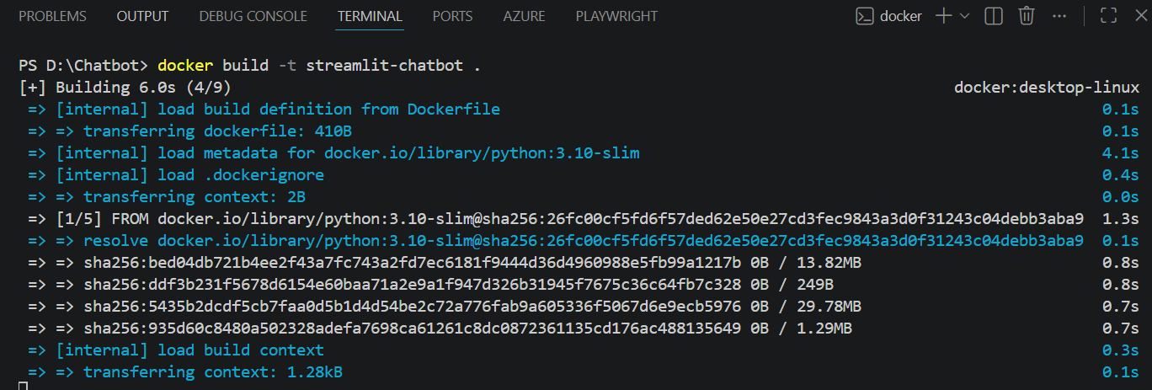
Setting up Chatbot – Building Docker image
Building image: Give the command
docker build -t streamlit-chatbot .

Slide 9
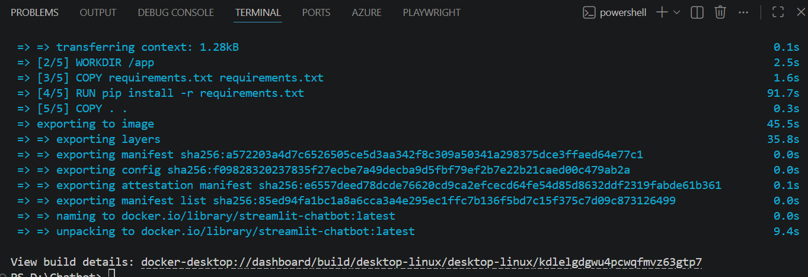
Setting up Chatbot – Building Docker image
Building image: Give the command
docker build -t streamlit-chatbot .

Slide 10
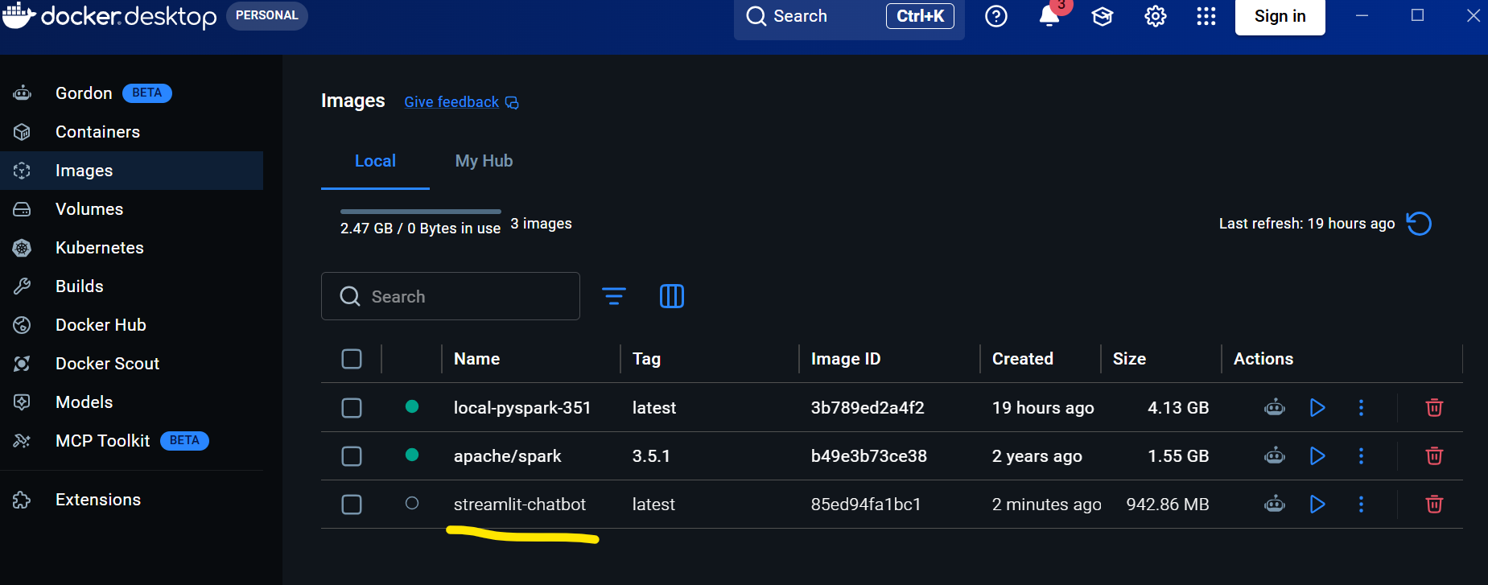
Setting up Chatbot – Building Docker image
Building image: Give the command
docker build -t streamlit-chatbot . We will see an image got created in docker desktop software app

Slide 11
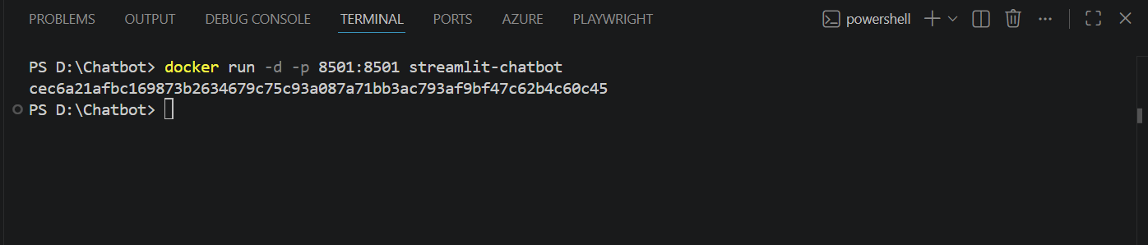
Setting up Chatbot – Running the image
Running image: Give the command
docker run -d -p 8501:8501 streamlit-chatbot

Slide 12
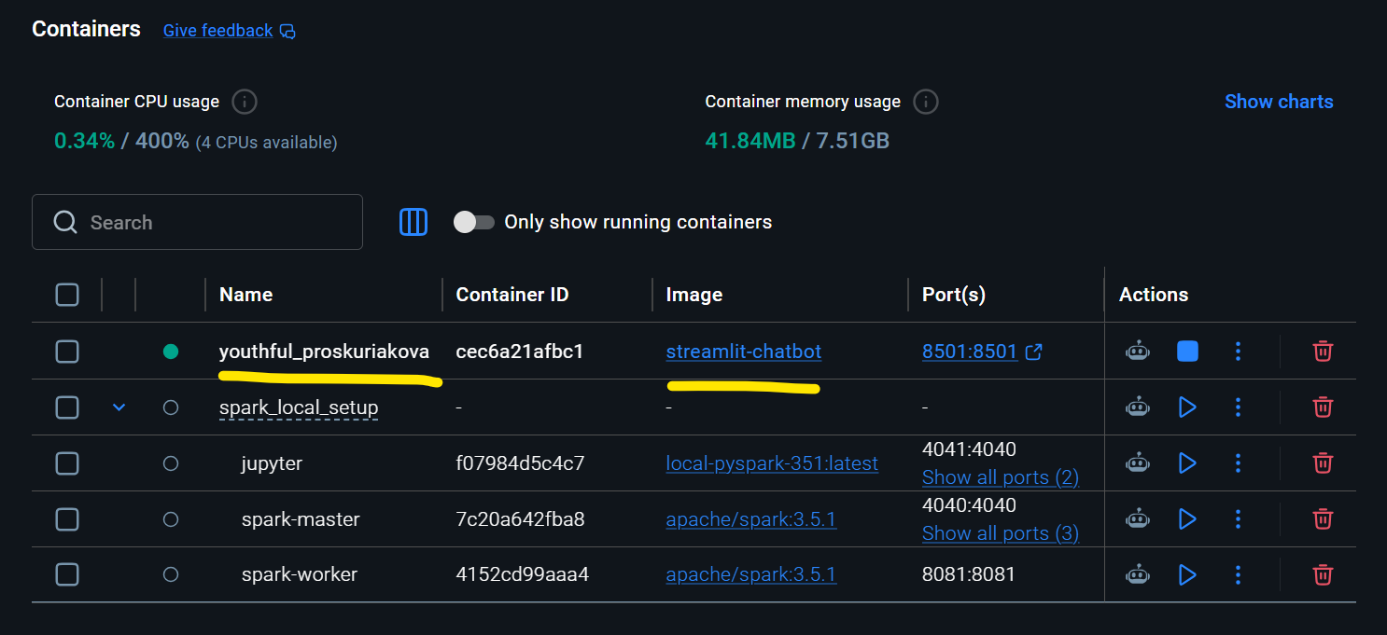
Setting up Chatbot – Running the image
Running image: Give the command
docker run -d -p 8501:8501 streamlit-chatbot

Slide 13
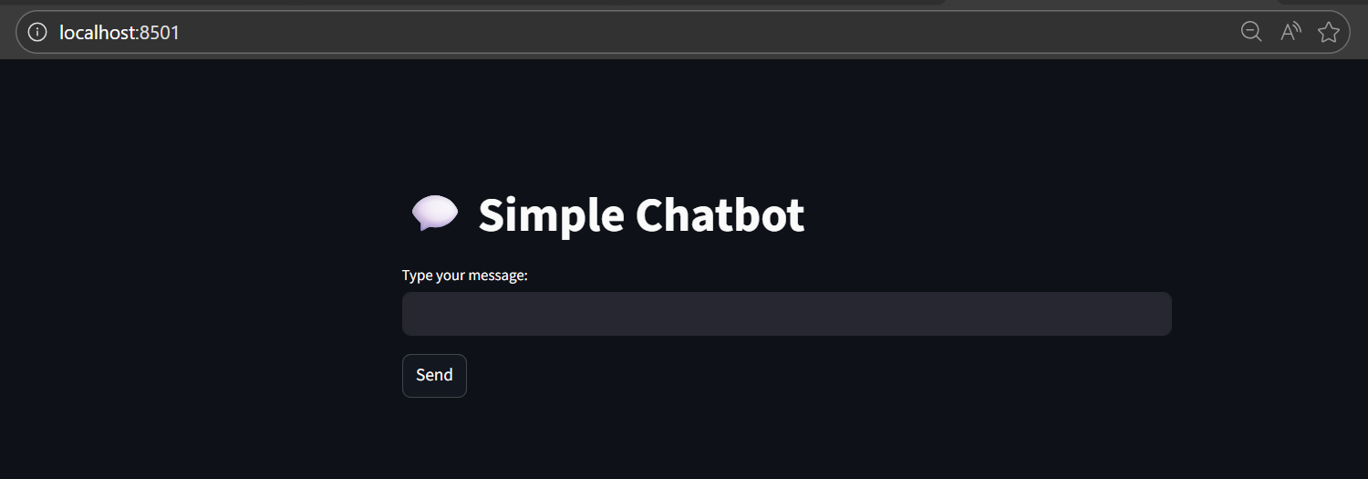
Setting up Chatbot
Now launch http://localhost:8501/
As long as docker container is running the UI will show

Slide 14
Setting up Chatbot – Ollama in Docker
Setting up a Docker container with an LLM engine so we can chat with it like a chatbot
Action | Purpose
Choose an LLM engine | Pick one that runs locally — e.g. Ollama, LM Studio, or Text‑Generation‑WebUI (for models like LLaMA, Mistral, or Falcon).
Create a Dockerfile | Define the environment (base image, dependencies, ports).
Expose an API endpoint | The container should serve a REST or WebSocket interface so you can send messages and receive responses.
Run the container | Use docker build and docker run to start the LLM engine.
Connect via client | You can interact using curl, Python scripts, or a simple web UI — just like chatting with a bot.

Slide 15
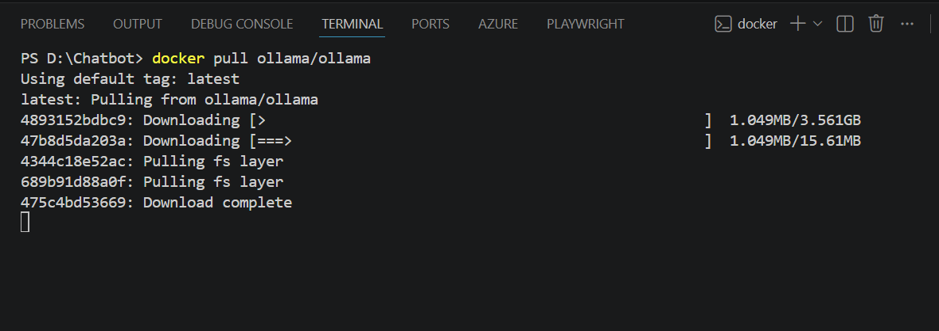
Setting up Chatbot – Ollama in Docker
Step A -> Execute command: ‘docker pull ollama/ollama’
Through this step the docker image is being pulled from official ollama site

Slide 16
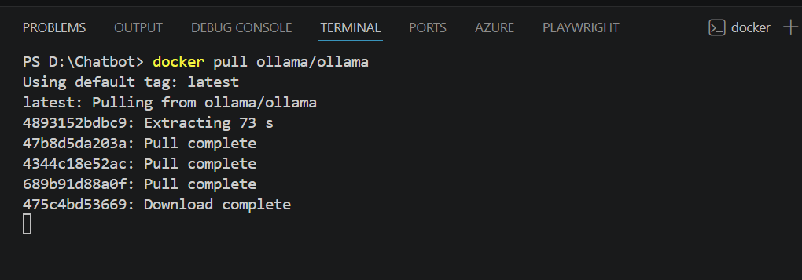
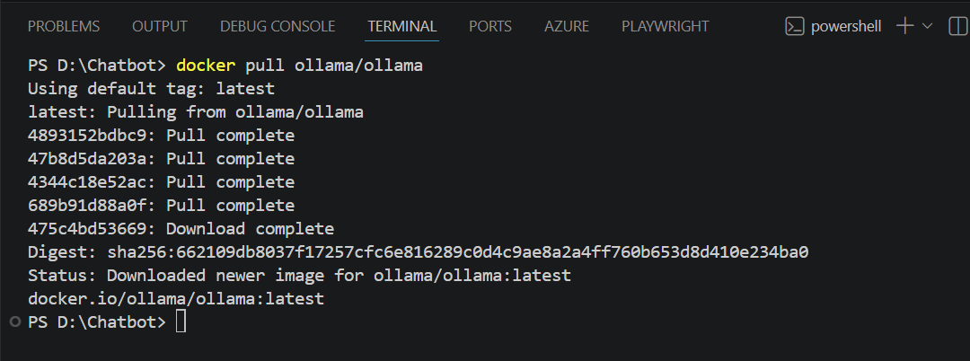
Setting up Chatbot – Ollama in Docker
Step A -> Building docker image

Slide 17
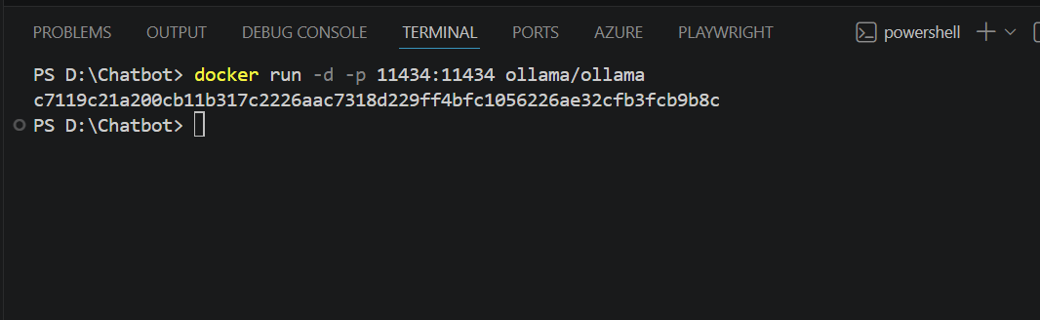
Setting up Chatbot – Ollama in Docker
Step A -> Running docker container
docker run -d -p 11434:11434 ollama/ollama

Slide 18
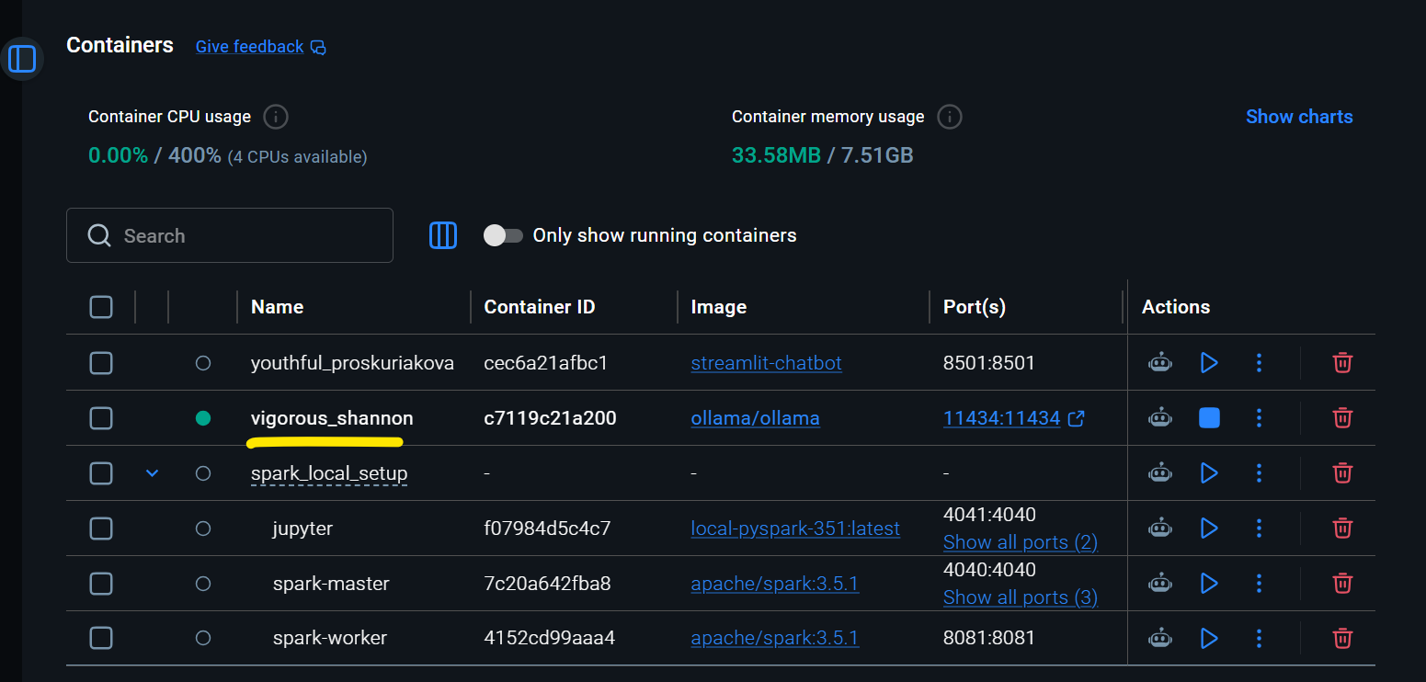
Setting up Chatbot – Ollama in Docker
Step A -> container is running as we see in Docker desktop
docker run -d -p 11434:11434 ollama/ollama

Slide 19
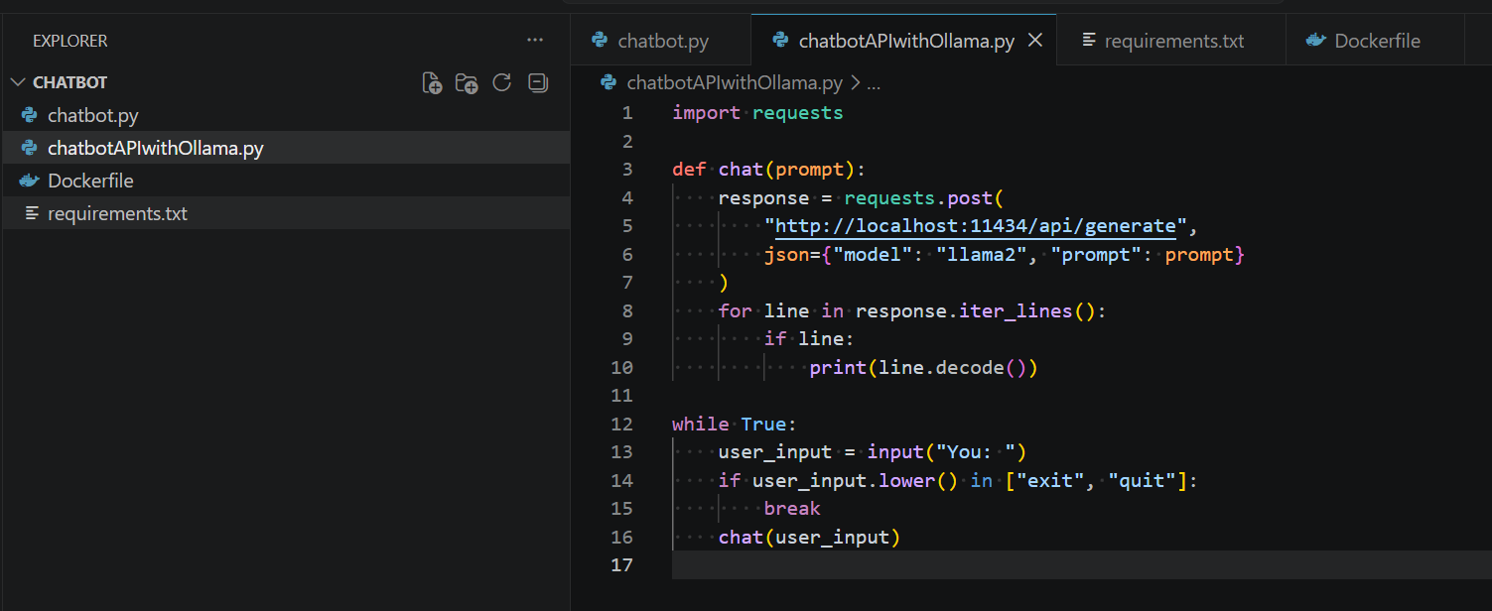
Setting up Chatbot – Ollama in Docker
Step B -> build a chatbot api (in python) where we can interact with ollama engine at port 11434 running llama2 model

Slide 20
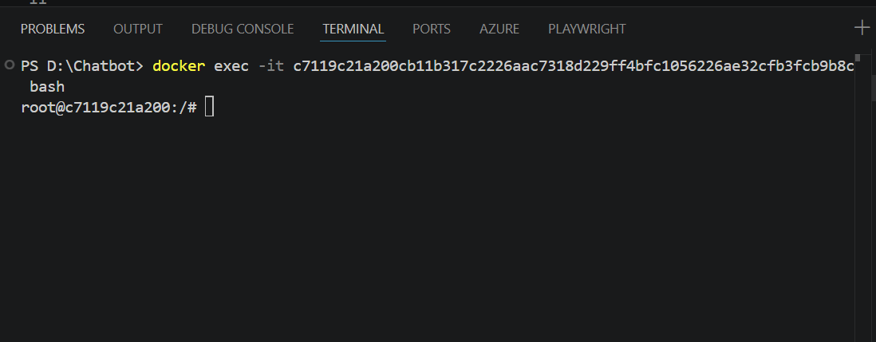
Setting up Chatbot – Ollama in Docker
Step B -> Now we have to pull ‘llama2’ model inside the container
To do that we have to enter inside the container:
docker exec -it <container-id / name> bash

Slide 21
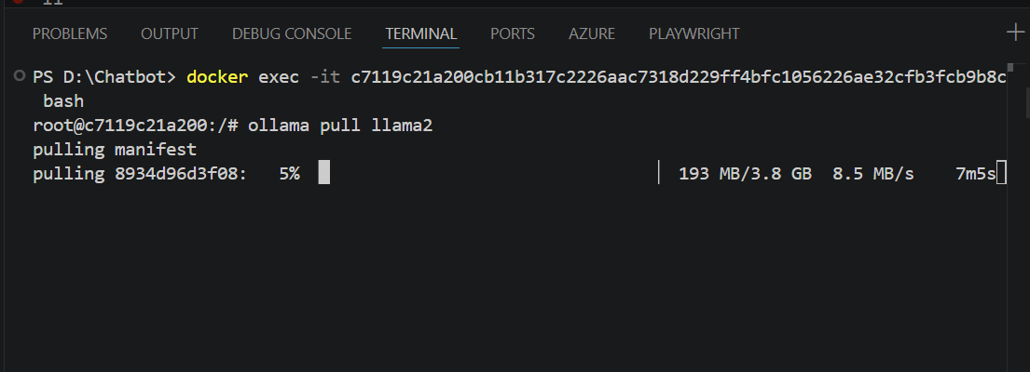
Setting up Chatbot – Ollama in Docker
Step B -> Now have to pull ‘llama2’ model inside the container
ollama pull llama2

Slide 22
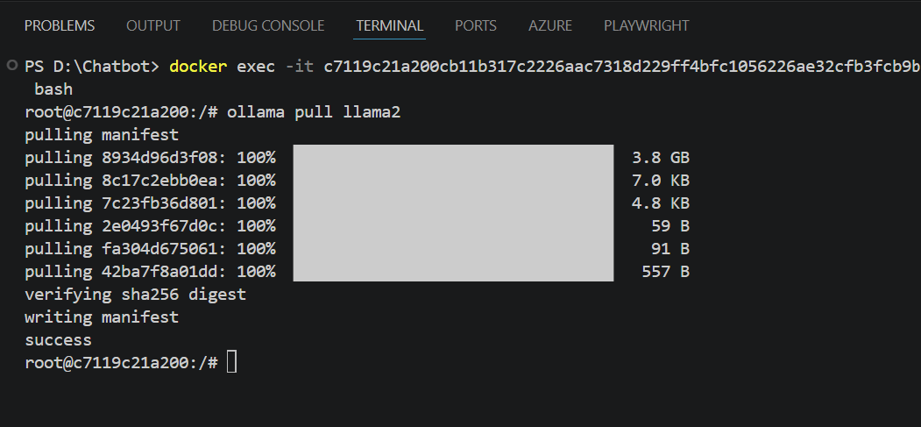
Setting up Chatbot – Ollama in Docker
Step B -> Now have to pull ‘llama2’ model inside the container
ollama pull llama2

Slide 23
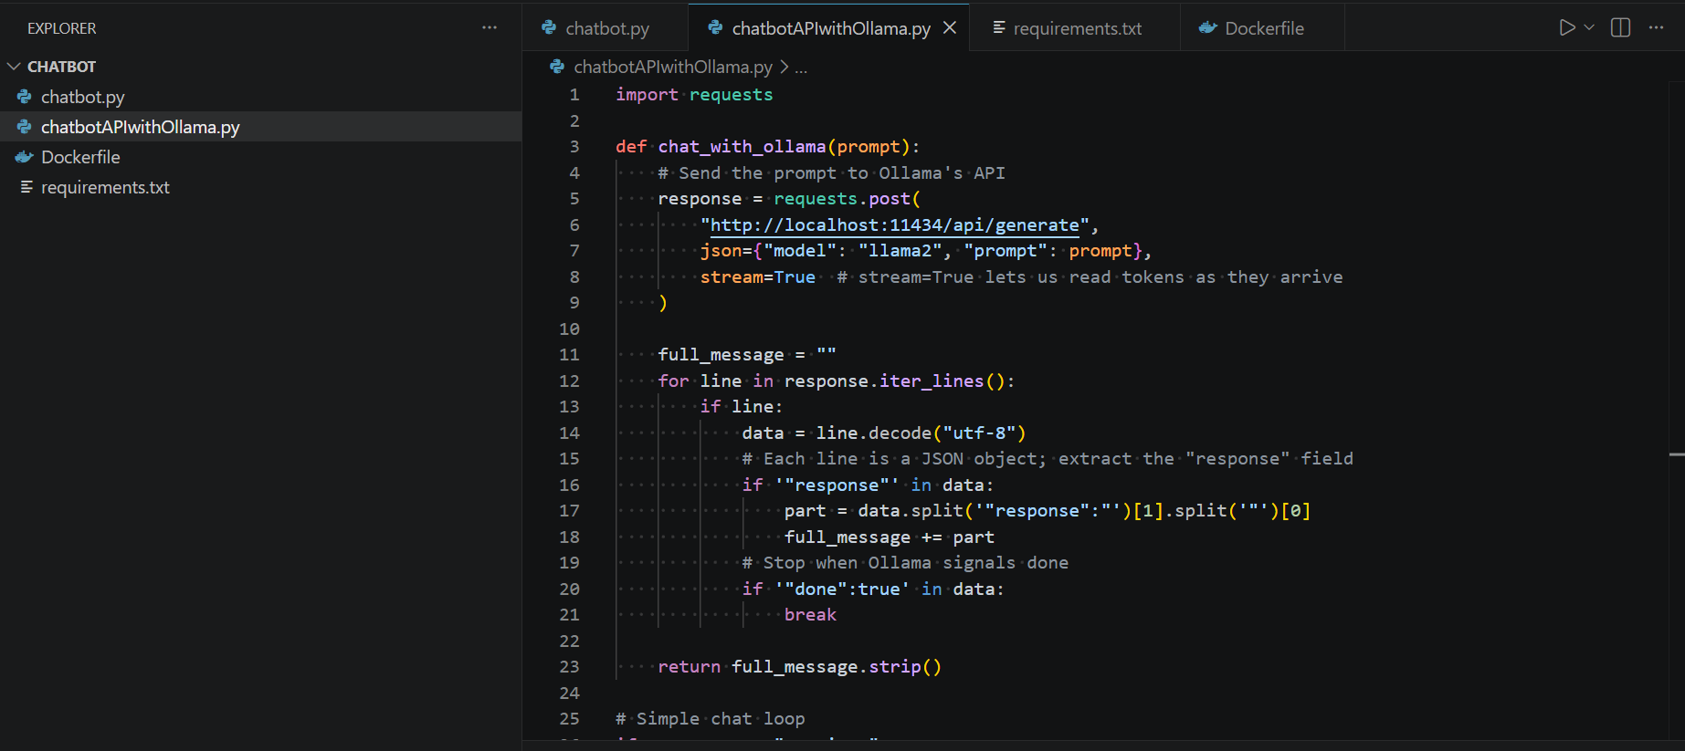
Setting up Chatbot – Ollama in Docker
Step C -> lets run the python script which will connect to ollama and initiate a chat via command line

Slide 24
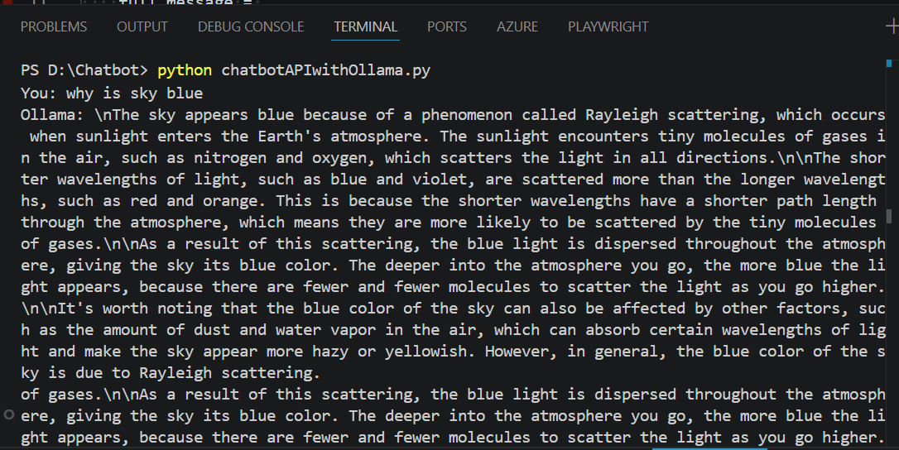
Setting up Chatbot – Ollama in Docker
Step C -> lets run the python script which will connect to ollama and initiate a chat via command line

Slide 25
Monitoring the Docker container
We want to see container CPU/memory graphs in Grafana, so we will go with cAdvisor + Prometheus + Grafana setup
We will use Docker Compose file that spins up all three together so you don’t have to run them one by one
docker-compose.yml
prometheus.yml

Slide 26
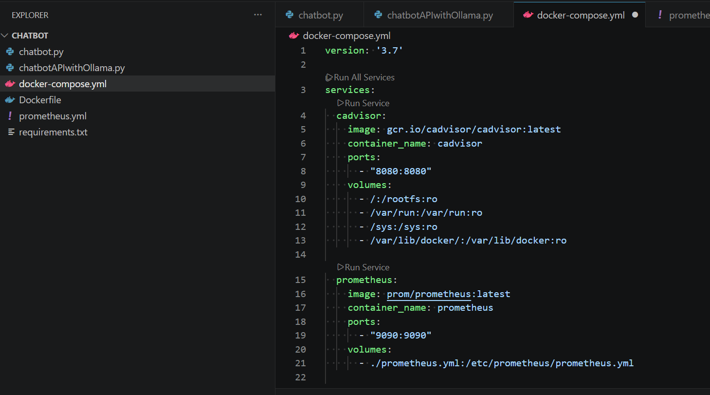
Monitoring the Docker container
docker-compose.yml

Slide 27
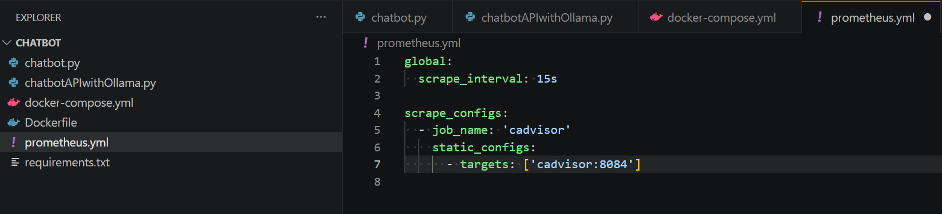
Monitoring the Docker container
prometheus.yml

Slide 28
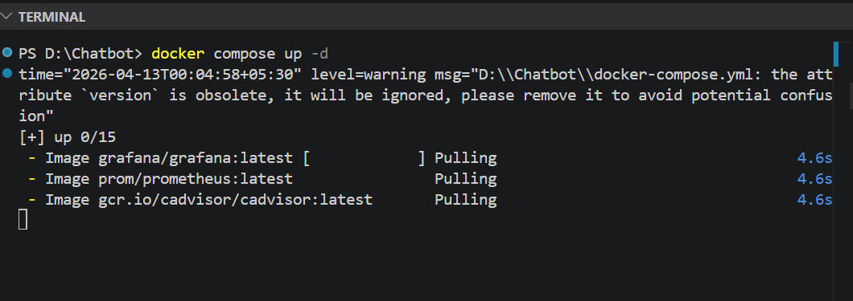
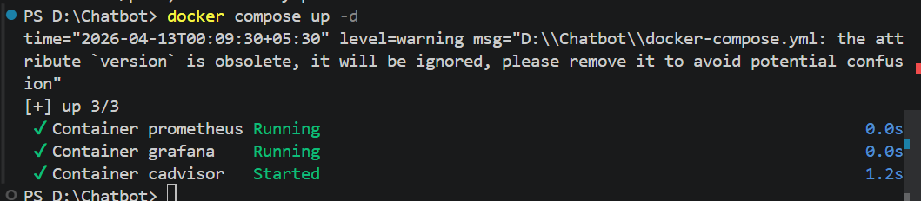
Monitoring the Docker container
Run docker compose: ‘docker compose up –d’

Slide 29
Monitoring the Docker container
Open:
Grafana → http://localhost:3000 (login: admin/admin)
Prometheus → http://localhost:9090
cAdvisor → http://localhost:8084

Slide 30
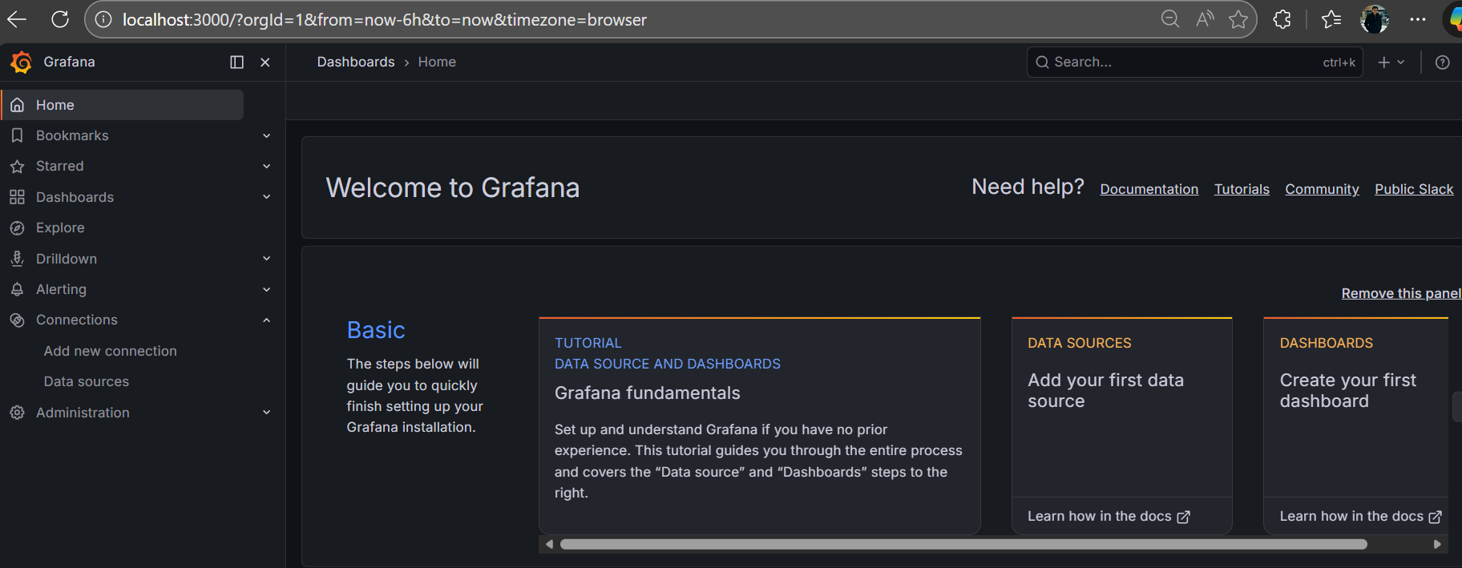
Monitoring the Docker container
Grafana → http://localhost:3000 (login: admin/admin)

Slide 31
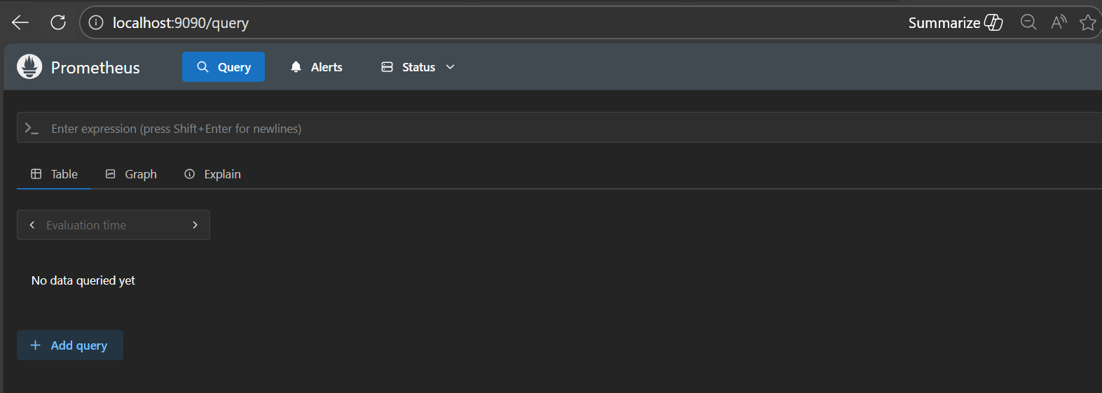
Monitoring the Docker container
Prometheus - http://localhost:9090

Slide 32
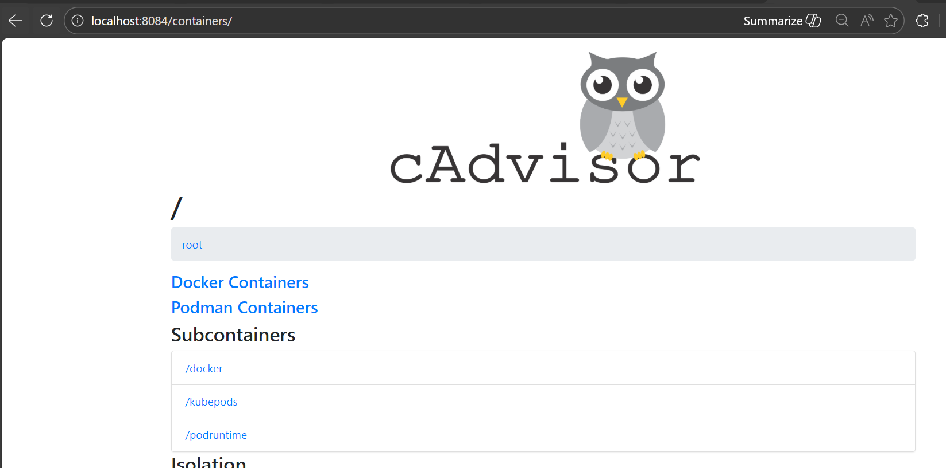
Monitoring the Docker container
cAdvisor → http://localhost:8084

Slide 33
Monitoring the Docker container
To monitor your Docker container usage in Grafana, you need three key pieces working together:
cAdvisor → collects per‑container metrics (CPU, memory, network, disk).
Prometheus → scrapes and stores those metrics.
Grafana → visualizes the metrics with dashboards.

Slide 34
Monitoring the Docker container
Run Grafana
Start Grafana (http://localhost:3000).
Add Prometheus (http://prometheus:9090) as a data source.

Slide 35
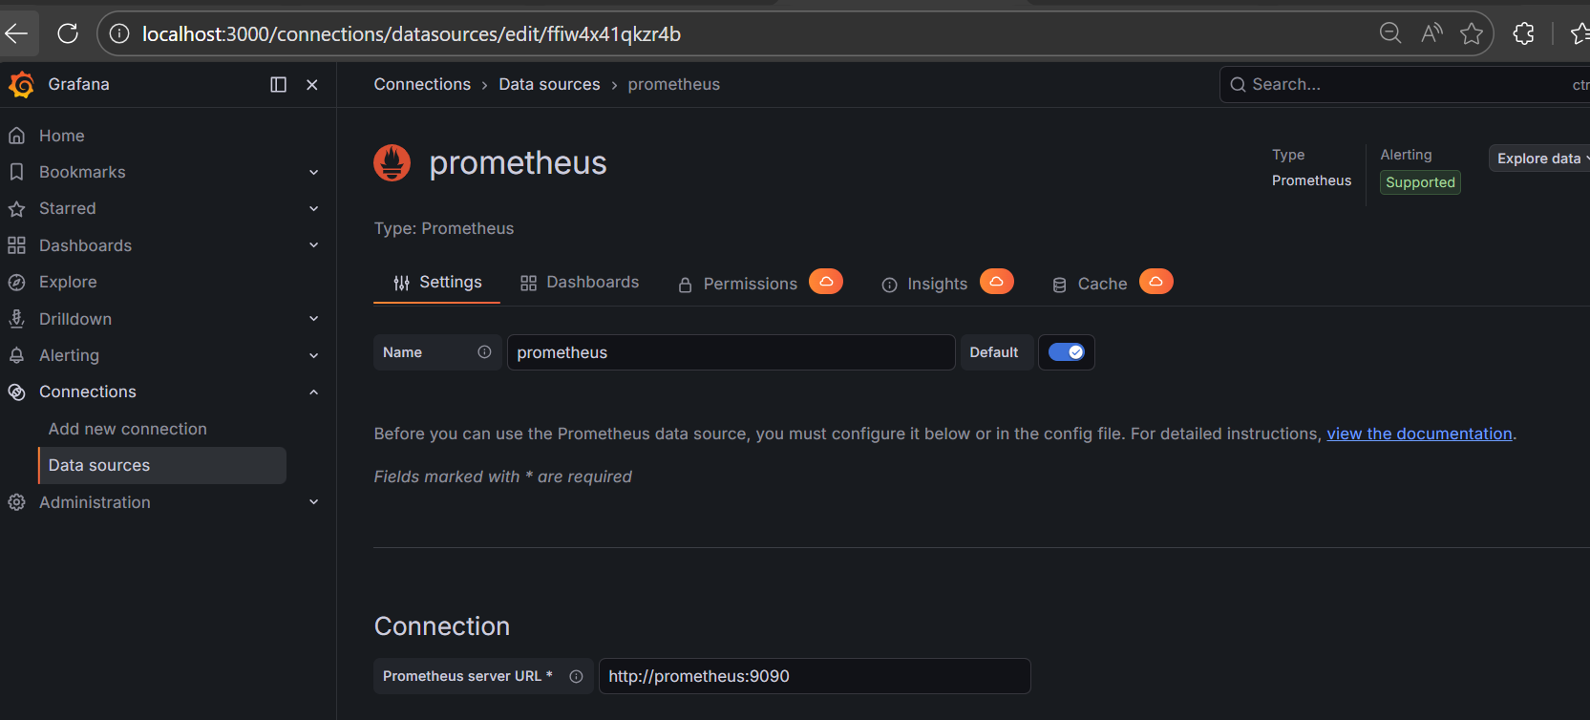
Monitoring the Docker container
Setting from Grafana

Slide 36
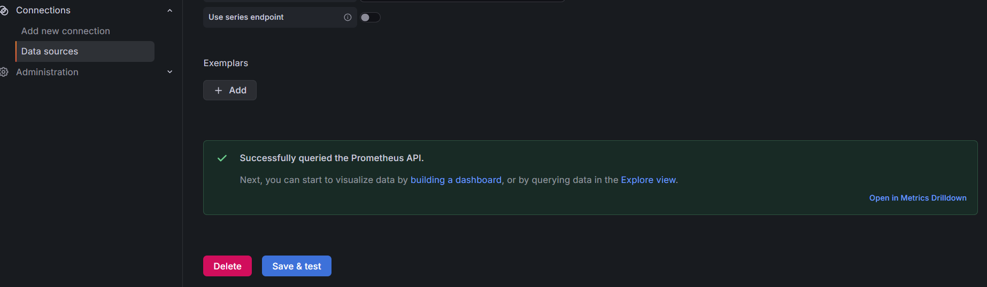
Monitoring the Docker container
Setting from Grafana

Slide 37
Monitoring the Docker container
Import a Docker Monitoring Dashboard
In Grafana, go to Dashboards → Import.
Use Dashboard ID 893 (Docker Monitoring with cAdvisor + Prometheus).
Select your Prometheus data source.

Slide 38
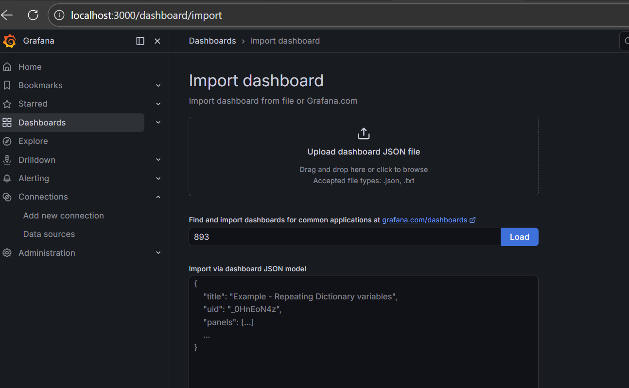
Monitoring the Docker container
Loading Dashboard 893

Slide 39
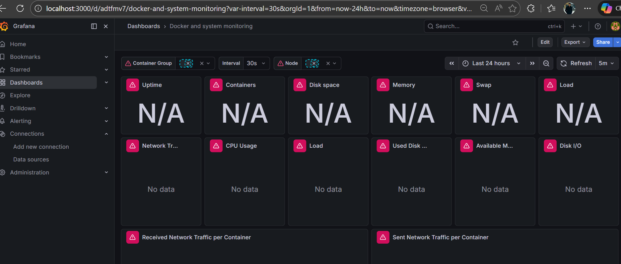
Monitoring the Docker container
Loading Dashboard 893

Slide 40
Load test against the chat url
We will create a jmx file that will hit the chat url continuously and generate load on the docker container holding the llm engine

